Slide 1
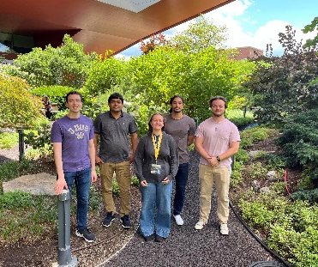
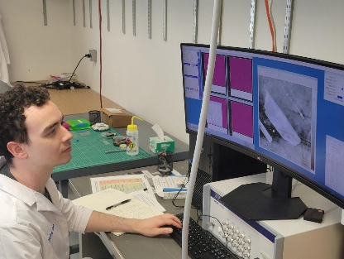
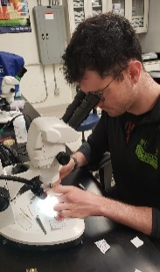
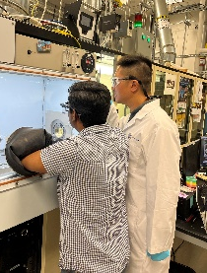
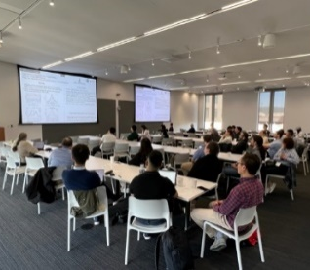
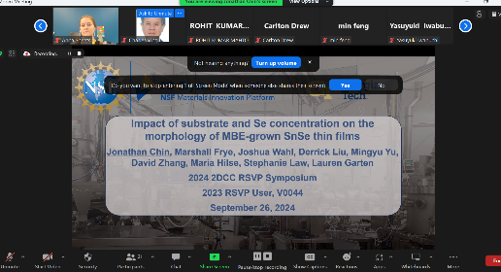

Resident Scholar Visitor Program (RSVP) 2024
2DCC MIP at Penn State,
DMR-2039351 & DMR-1539916
Broader Impact 2024
RSVP is a training and professional development program for visiting graduate students and early career researchers to learn on-site at the 2DCC for extended periods.
Kelsey Maxin, Ron Redwing, Stephanie Law, Kevin Dressler, Joan Redwing (2DCC-MIP).
2024 RSVPs
7 Total participants from summer 2024:
  4 Graduate students from R1 (3) and Non-R1 (1) institutions
  1 Postdoc from a Non-R1 institution
  1 Undergraduate student from a Non-R1 institution
  1 Industry visitor
Duration of visits: 2-3 months
Spread throughout facility: MBE (2), MOCVD (2), Bulk (2), Glovebox Cluster Tool (1)
Professional development (Graphene & Beyond workshop, seminars, weekly meeting)
Cumulative Outcomes
33 RSVPs hosted over past 4 years (60% from non R1)
7 manuscripts published/submitted
Intense hands-on training on equipment operation
Most projects directly enhance dissertation research
Development of skills for current and future positions
2024 RSVP Scholars at the 2DCC-MIP facility
Industry RSVP training in the MOCVD lab
Professional Development Activities
2024 RSVP Symposium held in September (6 RSVPs presented)
Notes:
What Has Been Achieved: The 2DCC hosted 7 RSVP students in the summer of 2024. The participants received hands on training in all areas of the 2DCC including Bulk Growth, MOCVD, MBE and Theory. Thus far we have sponsored 33 RSVP projects, 60% of projects are from non-R1 institutions, RSVPs have published/submitted 7 manuscripts so far and have given 5+ conference presentations from their RSVP experiences. RSVP trainees receive intensive onsite training to independently operate equipment and carry out their research. There is a competitive proposal process; students with accepted proposals spend anywhere from 2 weeks to several months at the 2DCC learning synthesis techniques and doing hands-on research in our facility.
Importance of the Achievement: Training the next generation crystal growers and theorists is critical to the 2DCC platform and the competitiveness of the U.S. in next generation semiconductor technologies.
Unique Feature(s) of the MIP that Enabled this Achievement: 2DCC’s platform focus on both knowledge sharing and materials discovery applied to training the next generation of growers and theorists combined with state-of-the-art facilities creates an environment for robust onsite learning opportunities and collaboration. This approach is the impetus for fueling new lines of collaborative research. RSVP trainees have also had the opportunity to collaborate with external users of 2DCC; a publication resulting from such a joint collaboration is included in the list below (publication #1).
RSVP Publications:
Aofeng Bai, Maria Hilse, Prasanna D. Patil (RSVP trainee, Non-R1), Roman Engel-Herbert, Frank Peiris (external user, Non-R1) Journal of Crystal Growth 591, 126714 (2022); DOI: 10.1016/j.jcrysgro.2022.126714
J.R. Chin (RSVP Trainee, R1), B.G. Gardner, M.B. Frye, D.S. Liu, S.A. Marini, J. Shallenberger, M.T. McDowell, M. Hilse, S. Law, L.M. Garten, MRS Communications, 2024, DOI: 10.1557/s43579-024-00630-8
M. Curtis (RSVP Trainee, Non-R1), O. Maryon, N. McKibben, J. Eixenberger, C. Chen, K. Chinnathambi, S. Pasko, S. El Kazzi, J.M. Redwing, D. Estrada, RSC Advances, 2024, DOI: 10.1039/D4RA04279D
M. Boora (RSVP Trainee, Non-R1), Y.-C. Lin, C. Chen, N. Trainor, J.A. Robinson, J.M. Redwing, J.Y. Suh, ACS Applied Materials Interfaces, 2024, DOI: 10.1021/acsami.3c14708
S. Shendokar, F. Aryeetey, M.F. Hossen (RSVP Trainee, Non-R1), T. Ignatova, S. Aravamudhan, Micromachines, 2023, DOI: 10.3390/mi14091758
R. Almaraz (RSVP Trainee, Non-R1), T. Sayer, J. Toole, R. Austin, Y. Farah, N. Trainor, J.M. Redwing, A. Krummel, A. Montoya-Castillo, J. Sambur, Energy & Environmental Science, 2023, DOI: 10.1039/D3EE01165H
J.R. Chin (RSVP Trainee, R1), M.B. Frye, D.S.H Liu, M. Hilse, I.C. Graham, J. Shallenberger, K. Wang, R. Engel-Herbert, M. Wang, Y.K. Shin, N. Nayir, A.C.T. van Duin, L.M. Garten, Nanoscale, 2023, DOI: 10.1039/d3nr00645j
Acknowledgements: Financial support for the RSVP program was provided by the National Science Foundation under cooperative agreement DMR-2039351, the Penn State 2D Crystal Consortium Materials Innovation Platform, Penn State Materials Research Institute, and The Pennsylvania State University.

